Slide 1


Deploying Nomad

Slide 2
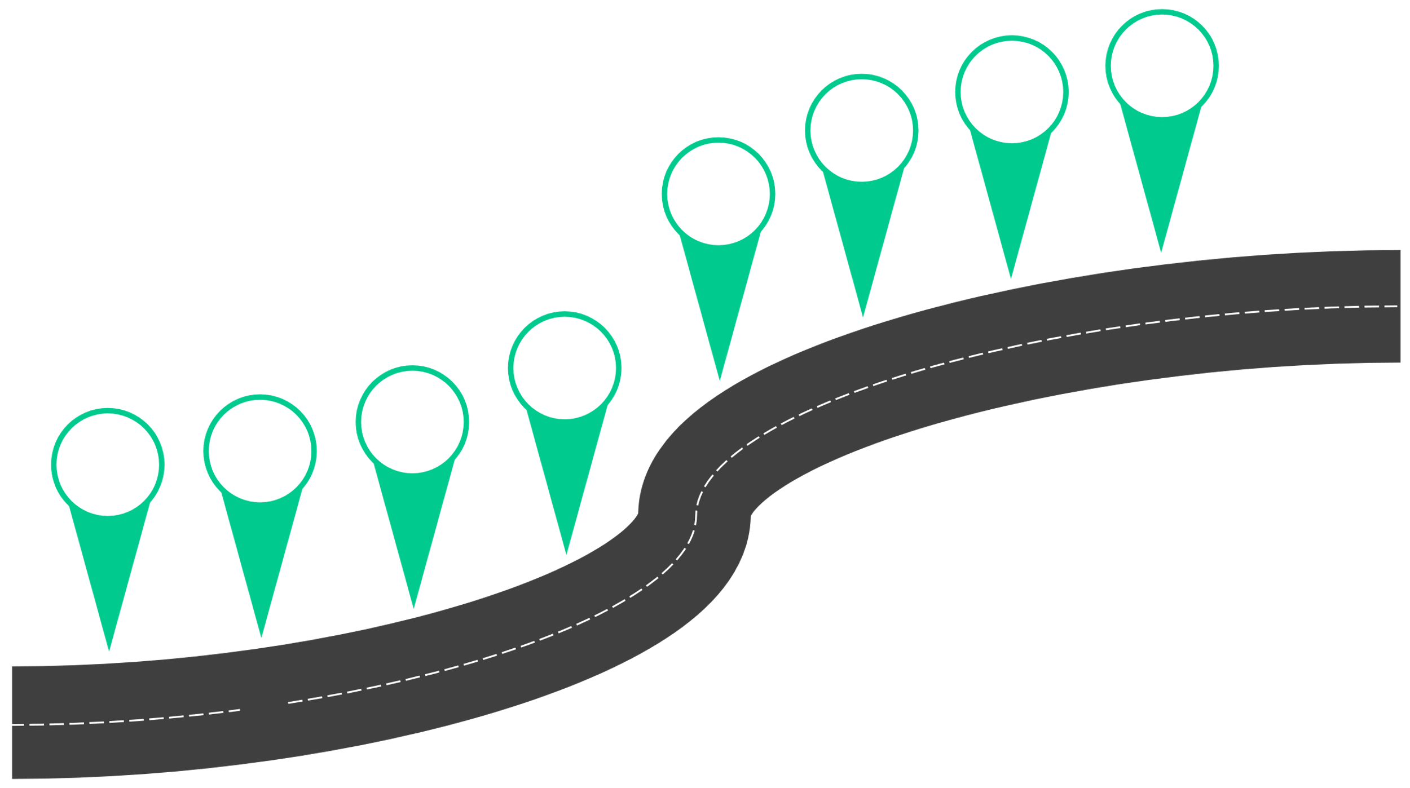






Nomad Journey
Day 2 Ops
Manage Workloads
Create Jobs
Job Config
Secure Nomad
Start Nomad
Intro Nomad
Install Nomad

Slide 3



Where Can I Find Nomad?
The easiest way to download and install Nomad is to use a package manager
MacOS users can use Homebrew
$ brew tap hashicorp/tap $ brew install hashicorp/tap/nomad
Linux users can use yum, apt-get, or other package managers
$ sudoyum install -y yum-utils shadow-utils $ sudoyum-config-manager --add-repo
https://rpm.releases.hashicorp.com/AmazonLinux/hashicorp.repo
$ sudoyum -y install nomad
Windows users can use Chocolatey
> choco
install nomad

Slide 4

Download it Manually
Download the latest version from the official HashiCorp Releases Site:
https://releases.hashicorp.com/nomad/
Download Binary
Unzip
Move to
Use Nomad
$PATH

Slide 5


















Use HashiCorp Packer
Create an AMI with Nomad and all Prerequisites
Amazon Machine
Image
Artifact Repository
Packer Config
VMware Template
Code Commit
Pipeline Job
Packer Build
Azure Managed
Image
Google Compute Image

Slide 6
DEMO
Installing Nomad
https://developer.hashicorp.com/nomad/docs/install

Slide 7



Let's Get
Nomad Running

Slide 8
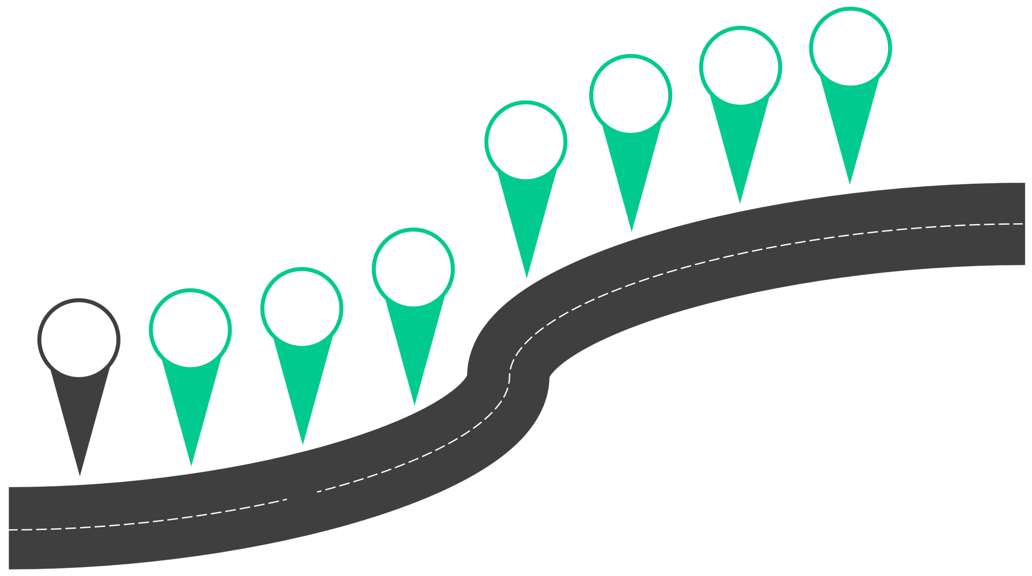




Nomad Journey
Day 2 Ops
Manage Workloads
Create Jobs
Job Config
Secure Nomad
Start Nomad
Intro Nomad
Install Nomad

Slide 9







Single Binary
Single Binary
Server Agent
Nomad Server forms the control plane for scheduling
Nomad Server
Client Agent
Nomad Client runs on the node which registers with the servers, watching for any work to be assigned and execute
tasks
Nomad Agent
Nomad Client

Slide 10
StartingtheNomad Service –DevMode
•
The Nomad agent can be started in development mode…
•
also known as: dev agent
•also known as: dev mode
This quickly starts a single agent on your local machine and acts
as a serverandclientfor testing
Dev mode should NEVERbe used for production…only testing
•
•
TERMINAL
$ nomad agent –dev –bind 0.0.0.0

Slide 11
Start Nomad Agent
•
Before we can start Nomad as a server or client, we first
need a configuration file
The configuration file is written in HCLand contains all the
information needed for Nomad to run
Configuration files differ slightly for Nomad servers vs. clients
•
• •
Drivers/prerequisites must be installed on Nomad clients, such as
Docker
Other configurations such as a Nomad user, directories, permissions,
and prerequisites must be done before starting a Nomad server
•
•
•
•
systemdconfig file
Local Nomad user to run the service
Directoriesfor storing configs and logs
Find useful files and configurations here:
btk.me/nomad

Slide 12
Agent Configuration File
Primary parameters for the configuration file:
•
• • • • • • • • • • • •
name–name of the local Nomad agent data_dir–directory where Nomad will store agent state (data) bind_addr–what IP address the Nomad agent should bind to for networking
advertise{}–what IP(s) to use to advertise for network services
ports{}–specify the ports used for different services
tls{}–TLS configurations datacenter–defines what datacenter the local agent is a member of log_file–where does store Nomad logs
server{}–Nomad server configuration (not needed for clients)
client{}–Nomad client configuration (not needed for servers)
acl{}–ACL configuration (enable, TTLs)
vault{} –configuration of Vault integration
consul{} –configuration of Consul integration
{} = stanza

Slide 13
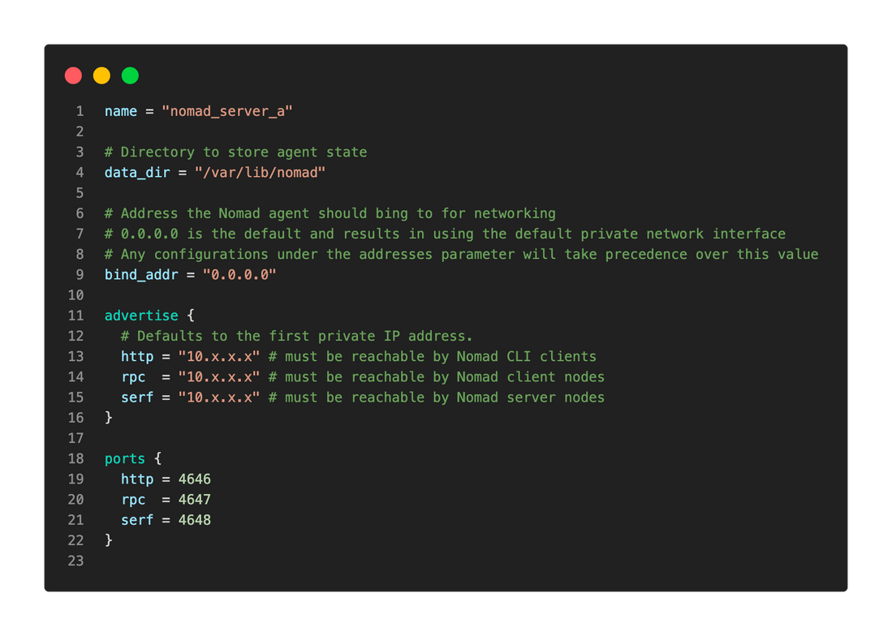
Agent Configuration File
https://btk.me/nomad_server

Slide 14
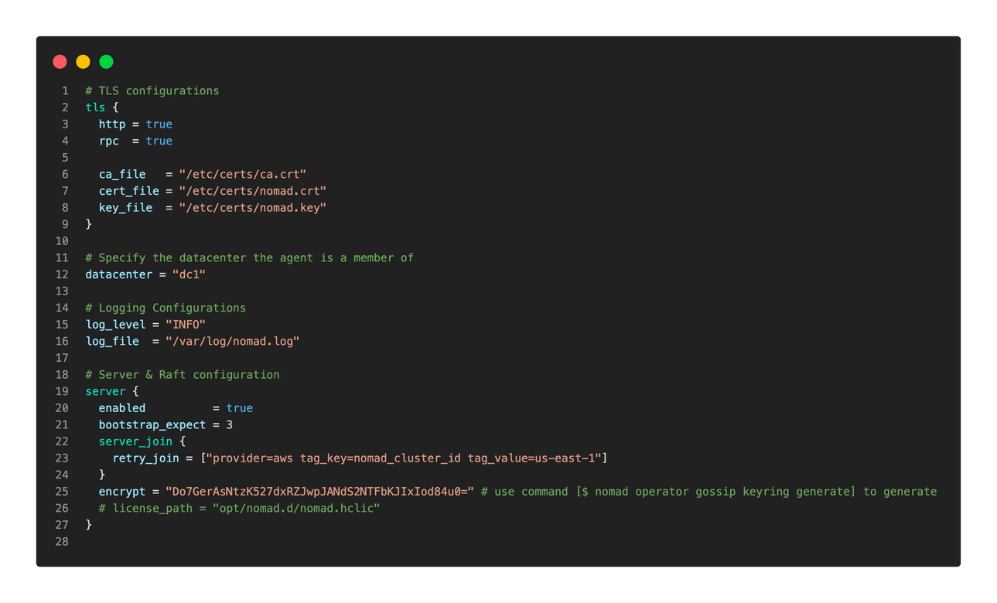
Agent Configuration File
File Continued from Previous Slide
https://btk.me/nomad_server

Slide 15
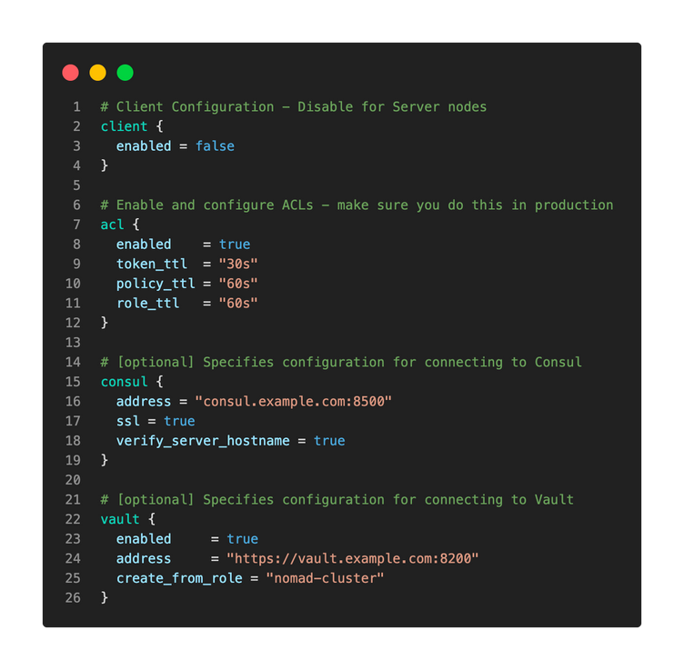
Agent Configuration File
File Continued from Previous Slide
https://btk.me/nomad_server

Slide 16

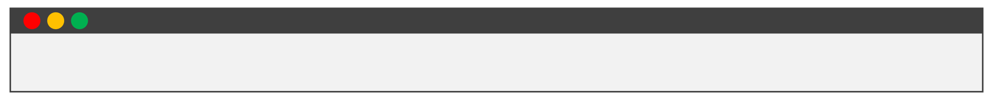
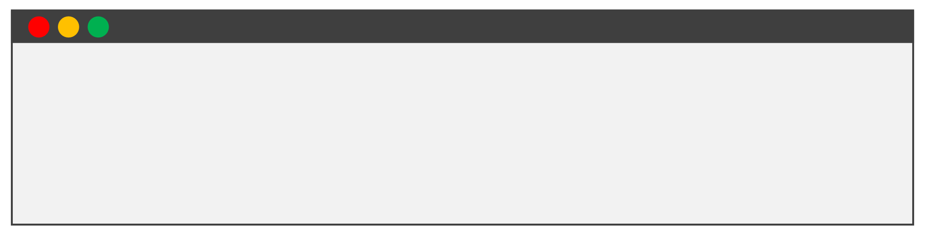

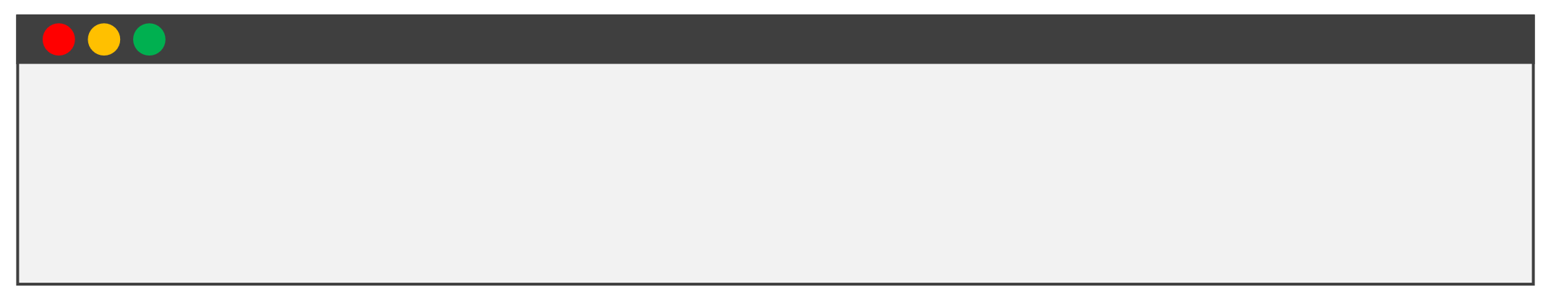
Other Tasks Needed
1 2
Create a local Nomad user
TERMINAL
$ useradd
--system --home /etc/nomad.d
--shell /bin/false nomad
Create a Directory Structure
TERMINAL
$ sudo $ sudo $ sudo
$ sudo
mkdir chown
-p /etc/nomad.d
nomad:nomad
/etc/nomad.d
touch /etc/nomad.d/server.hcl
/etc/nomad.d/data
mkdir
Note: If you use a
Package Manager, many of these tasks
3
Create the systemdservice file
TERMINAL
are done for you
$ sudo $ sudo
touch /etc/systemd/system/nomad.service vi /etc/systemd/system/nomad.service
<paste file from GitHub here>

Slide 17
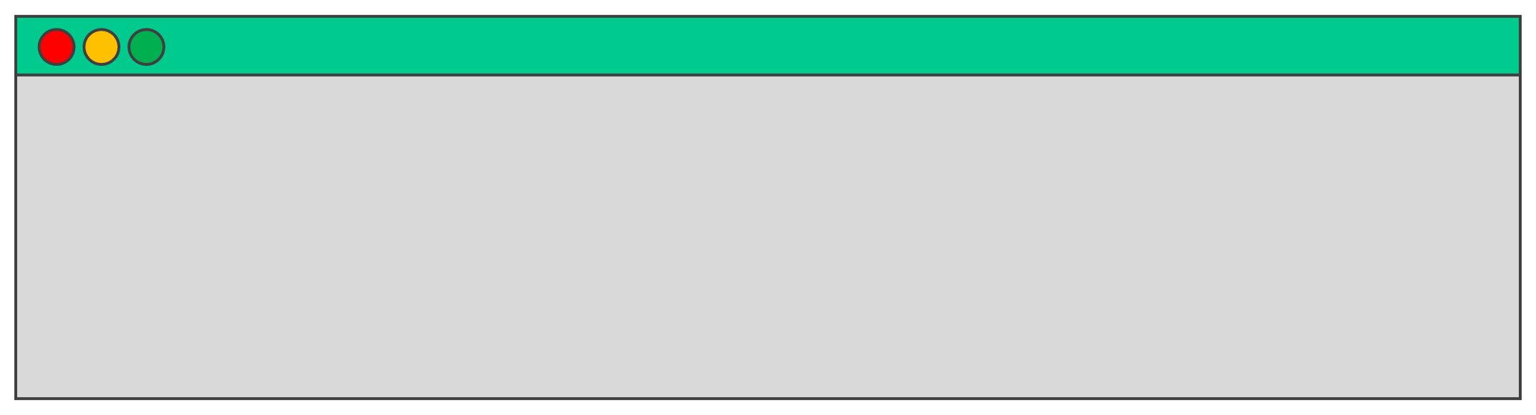
Start Nomad Agent
•
Now that we have all the requirements, we can start the
Nomad server
•
Normally our service manager would be configured to start the Nomad server for us by executing the command below In Linux, this is systemctlor similar. Windows would be Windows
•
Service Manager
•
However, you can start Nomad manually if you want using the Nomad command:
TERMINAL
# Start Nomad by point to a config file $ nomad agent –config /etc/nomad.d/server.hcl
Find useful files and configurations here:
btk.me/nomad
# Start Nomad by pointing to a directory $ nomad agent –config /etc/nomad.d

Slide 18
DEMO
Starting the Nomad Service

Slide 19
Nomad Server
Clustering

Slide 20
Typcial Deployment Architecture
•
In a production environment, you'll need high availability that single node doesn't provide you
A typical deployment architecture includes 3-5 servers per Nomad cluster
The servers use the Raft protocol to elect a cluster "Leader" to manage
priorities, evaluations, and allocations. The leader replicates data to followers
The server nodes must maintain a quorum to ensure the Nomad service is up
and running
• •
•
•
•
3-node cluster provides a failure tolerance of 1 node
5-node cluster provides a failure tolerance of 2 nodes

Slide 21




Nomad Architecture
Nomad Datacenter
FORWARDING
FORWARDING
REPLICATION
REPLICATION
SERVER
SERVER
SERVER
SERVER
SERVER
FOLLOWER
FOLLOWER
LEADER
FOLLOWER
FOLLOWER
REPLICATION
REPLICATION
FORWARDING
FORWARDING
Five Node Cluster
Suitable for Production Environment

Slide 22
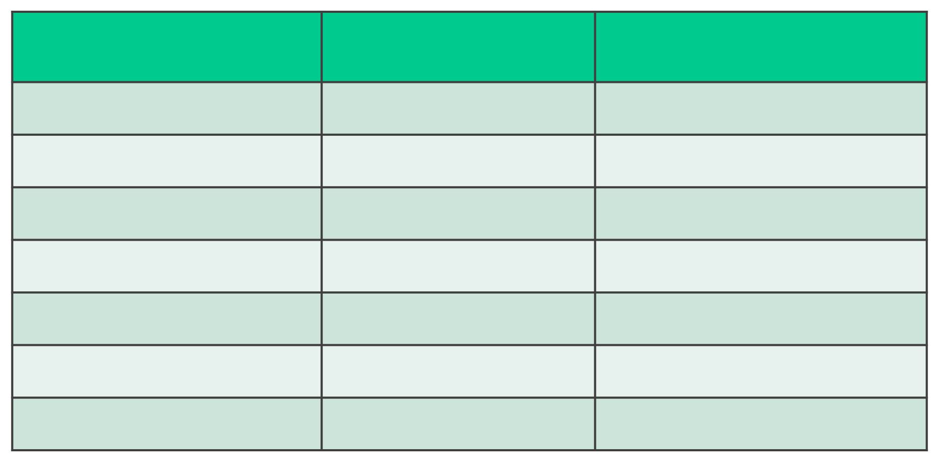
Raft Overview
•
Raft is the consensus protocol used by Nomad Only server nodes participate in Raft and make up the peer set All client nodes forward requests to servers
Nomad Servers 1
2
3
4
5
6
7
Quorum Size 1
2
2
3
3
4
4
Failure Tolerance 0
•
0
1
1
2
2
3
•
•Servers elect a leader and will automatically
elect a new leader if the current leader becomes unavailable
•A quorum must be maintained, otherwise,
Nomad cannot process log entries or elect a leader –Nomad will be unavailable
Quorum =
n= the number of servers
(n/2)+1

Slide 23
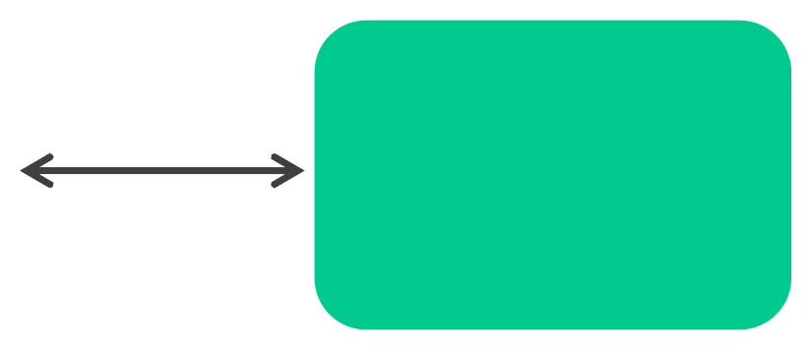

Networking
DATACENTER A
DATACENTER B
RPC- tcp/4647 Gossip – tcp/4648 Gossip – udp/4648
RPC- tcp/4647 Gossip – tcp/4648 Gossip – udp/4648
SERVER
SERVER
LEADER
SERVER
CLUSTER
FOLLOWER
FOLLOWER
WAN Gossip tcp/4648 udp/4648
Client tcp/4647
Client tcp/4647
API tcp/4646
API tcp/4646
CLIENT
CLIENT
User/Automation

Slide 24
Networking
•Servers should be able to communicate over a high bandwidth, low latency
network
•Recommended to have <10ms latency between cluster members
•Nomad servers can be spread across cloud regions or datacenters if they
meet the latency requirements

Slide 25


System Requirements For Nomad Servers
(recommended)
Type
Small
CPU 2-4 core
Memory 8-16GB RAM
Disk 50GB
Typical Cloud Instance Types AWS: m5.large, m5.xlarge
Azure: Standard_D2_v3,
Standard_D4_v3
GCP: n2-standard-2, n2-standard-4
AWS: m5.2xlarge, m5.4xlarge
Large
8-16 core
32-64GB RAM
100 GB
Azure: Standard_D8_v3,
Standard_D16_v3
GCP: n2-standard-8, n2-standard-16

Slide 26
Joining Servers to a Cluster
• •
Servers need to know how to connect to each other to form a cluster This can be done manually or automated using parameters the configuration file
•
For most environments, configuration to automatically discover and join server agents to form a cluster will be done using the configuration file
FORWARDING
REPLICATION
SERVER
SERVER
LEADER
SERVER
FOLLOWER
FOLLOWER
REPLICATION
FORWARDING

Slide 27

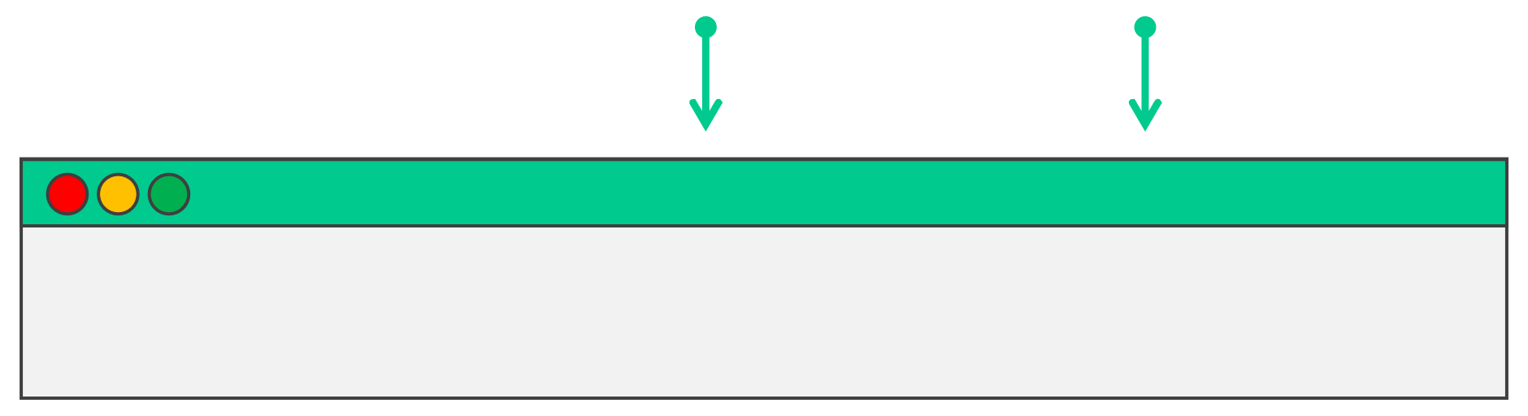
Joining Servers to a Cluster
• •
Provision and setup your server nodes Manually join nodes b& cto node ato create a cluster
Join Manually
server_a
server_b
server_c
TERMINAL
$ nomad server join server_a.example.com:4648

Slide 28
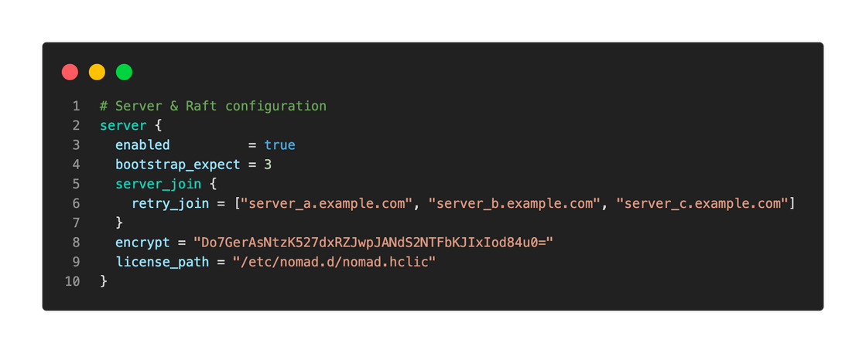
Joining Servers to a Cluster
Automated (preferred)
Use the
retry_joinparameter to instruct Nomad to connect to the
server agents listed. Can use DNS names or IP addresses
Host names or IP addresses

Slide 29
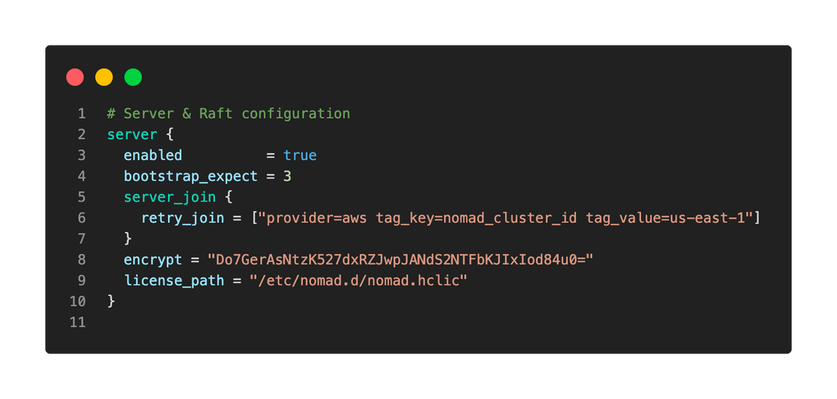
Joining Servers to a Cluster
Automated (preferred)
Use cloud tags to allow Nomad to automatically discover and join servers to create the cluster. Need permissions on cloud platform for discovery.
Cloud Auto Join

Slide 30
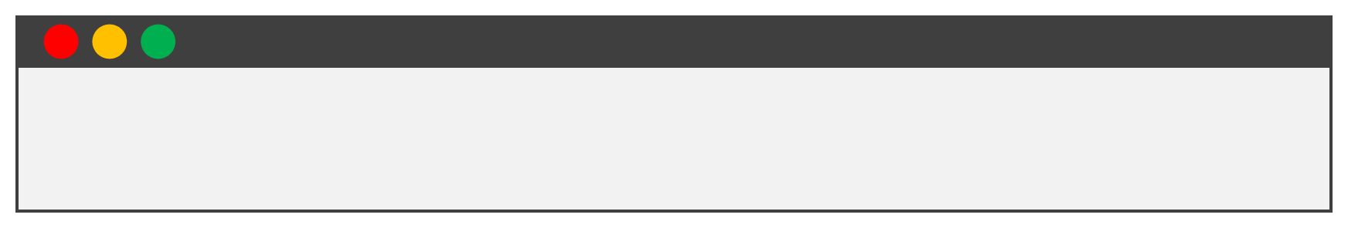
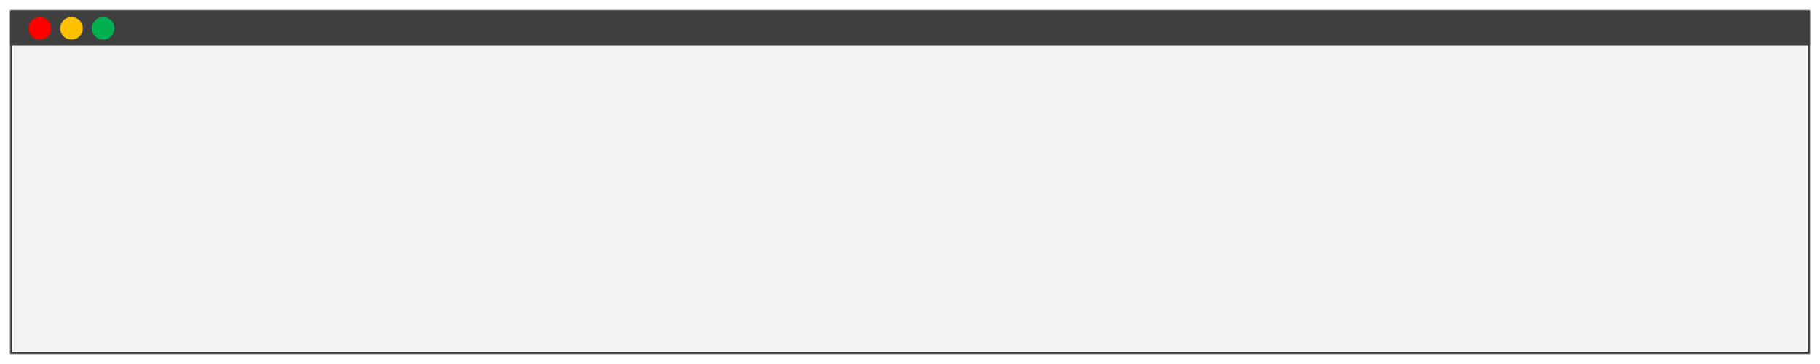
View theServersin theCluster
Display a list of known servers and their status
TERMI NAL
$ nomad server members
TERMI NAL
$ nomad server members
Name
nomad_svr_a.global
nomad_svr_b.global
nomad_svr_c.global
Address
10.0.102.53 4648 alive
10.0.101.81 4648 alive
10.0.101.72 4648 alive
Port Status Leader Raft Version Build Datacenter Region
global
global
global
true
false
false
3
3
3
1.4.3 dc1
1.4.3 dc1
1.4.3 dc1

Slide 31
DEMO
Creating a Nomad Cluster

Slide 32
Nomad Clients

Slide 33
Nomad Clients
•
Nomad clients are members of the Nomad datacenter responsible for executing tasks and jobs
•
In other words, Nomad clients are responsible for running the containers and
applications scheduled by Nomad
•
Clients register with Nomad servers and the agent runs on dedicated servers (usually VMs) to maximize the resources available to run tasks and jobs
You can have multiple clients in a cluster and Nomad servers allocate
jobs to clients with its scheduling algorithm
•

Slide 34



Nomad Datacenter
Single-Region Architecture
FORWARDING
REPLICATION
SERVER
FOLLOWER
SERVER
LEADER
SERVER
FOLLOWER
REPLICATION
FORWARDING
RPC
RPC
RPC
CLIENT
CLIENT
CLIENT

Slide 35
Nomad Clients
• •
Nomad Agent will run on the client with a client configuration Since workloads run on Nomad clients, other prerequisites need to be met
before tasks and job
For example, if you are running containers, you might need Docker or
containerdinstalled and running, If you want virtualized workloads, you
can install Firecracker or QEMU
Nomad task driver binaries must also be downloaded and installed on the
client as well
•
•

Slide 36
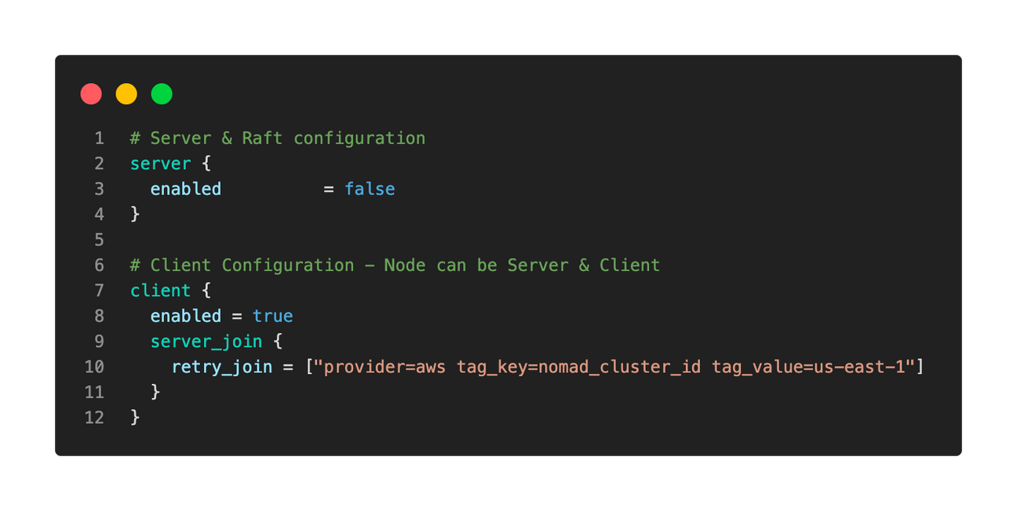
Nomad ClientConfiguration

Slide 37
Adding Clients to the Nomad
DEMO
Cluster

Slide 38
Removing
Cluster Members

Slide 39
RemovingServer NodesfromtheCluster
•
You might need to remove server nodes from the cluster to perform operations such as:
• •
Regularly scheduled maintenance Upgrading to new version of Nomad
•
It's important that you remove server nodes the proper way to ensure Nomad (raft) is aware of your intentions
TERMINAL
# Remove a node using the id $ nomad operator raft remove-peer –peer-id="nomad_server_a"
# Remove a node using the IP address $ nomad operator raft remove-peer –peer-address="10.0.3.45:4646"

Slide 40
Removing Clients from the Cluster
•
You might need to remove clientsnodes from the cluster to perform operations such as:
• • •
Regularly scheduled maintenance Upgrading to new version of Nomad Reducing cluster size because of reduced performance needs or cost savings
1.
To ensure workloads are not impacted, you should disable scheduling eligibility on node(s) you want to remove
2.
Next, drain the client to migrate all existing allocations to other clients
3.
Finally, stop the Nomad service and decommission the node

Slide 41
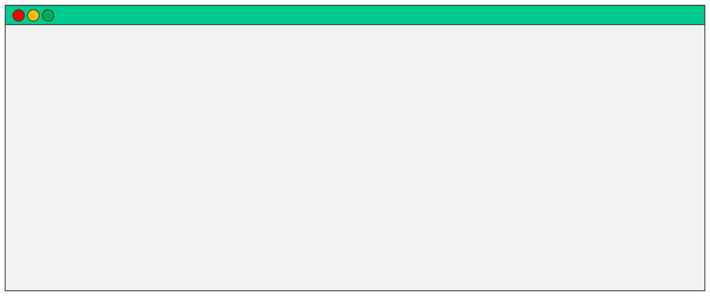
Removing Clients from the Cluster
TERMINAL
# View the status of the nodes in a cluster $ nomad node status
# View the status of node, events, resources, and allocations $ nomad status <node_id>
# Disable a client's eligibility to accept new allocations $ nomad node eligibility –disable <node_prefix>
# Drain the allocations from a client node $ nomad node drain –enable <node_prefix>

Slide 42
DEMO
Working with Cluster Members

